Slide 1
Technology:
Motion
(examples & animations)

Slide 2
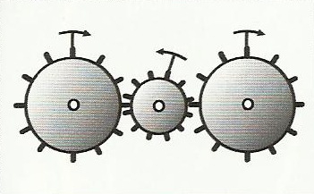
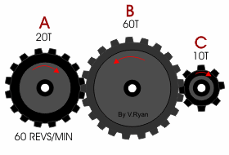
GEAR TRAINS:

Slide 3
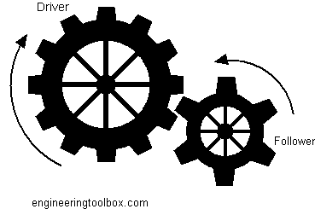
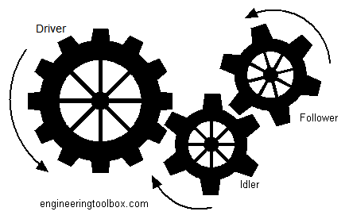
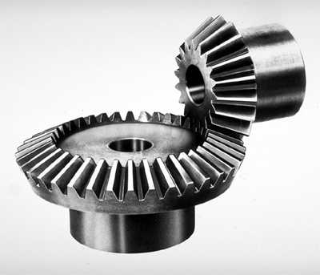
Clockwise
Counter-Clockwise
Counter-Clockwise
Clockwise
Counter-Clockwise

Slide 4
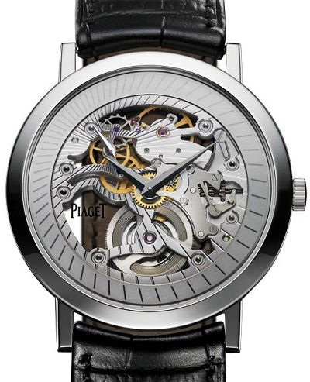
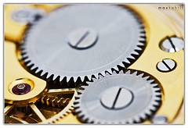
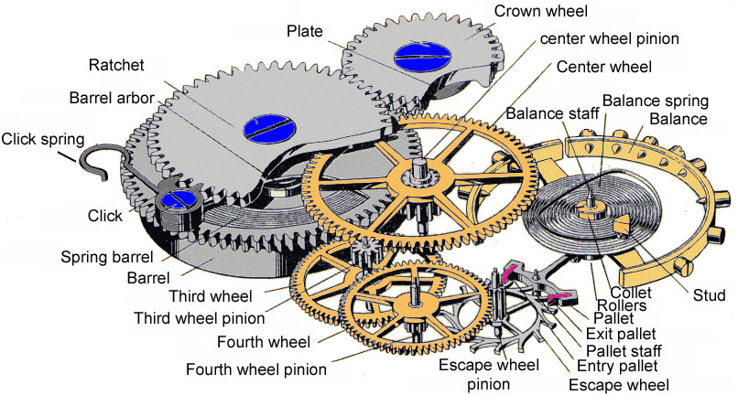

Slide 5
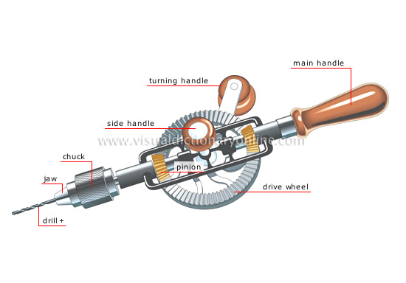
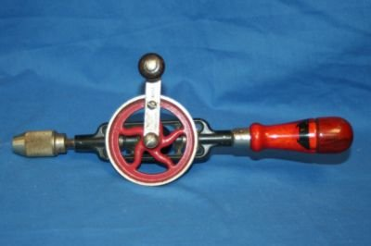

Slide 6
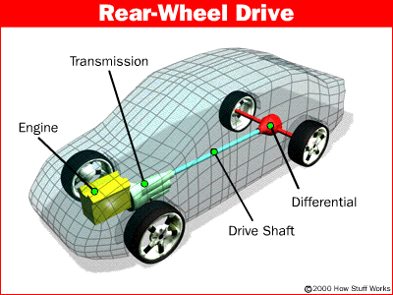
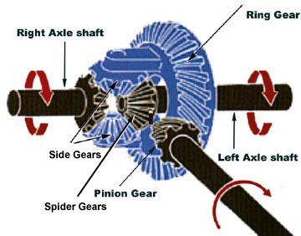
Automotive
Differential
(gear sets)

Slide 7
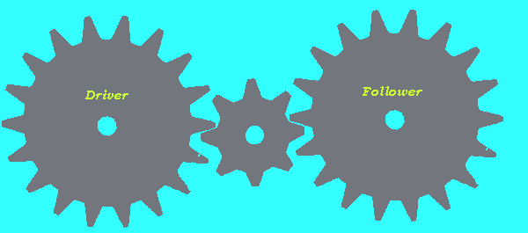

Slide 8
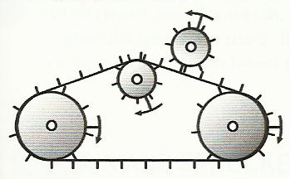
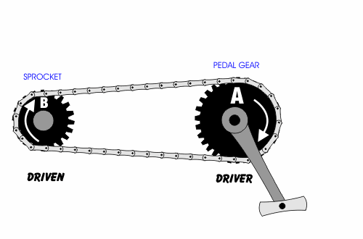
CHAIN AND SPROCKET SYSTEMS:

Slide 9
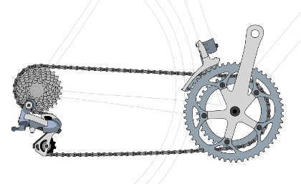
Chain
Sprocket
(small)
Sprocket
(Large)
Clockwise
Clockwise

Slide 10
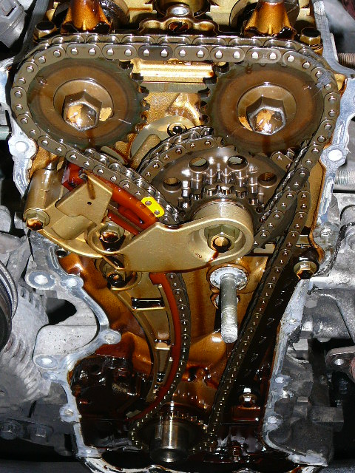
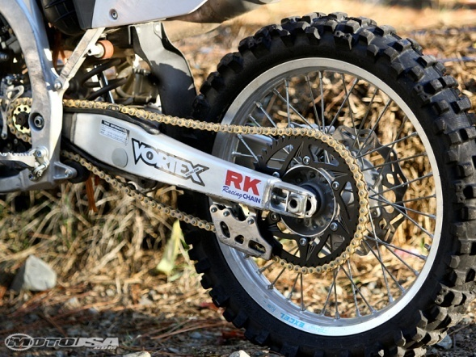

Slide 11
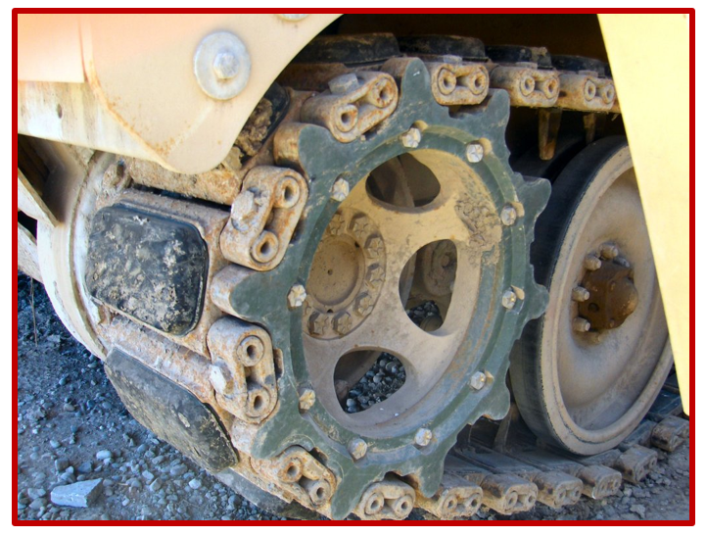

Slide 12
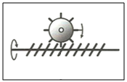
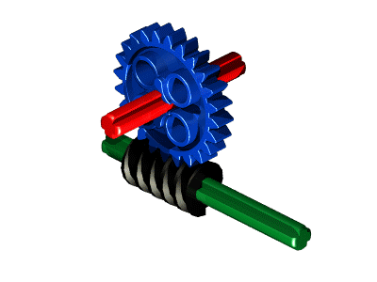
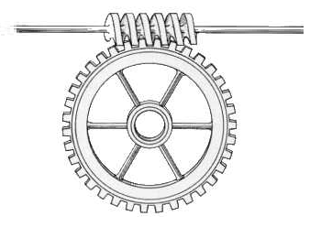
WORM & WORM GEAR SYSTEMS:
Worm (screw)
Worm Gear

Slide 13
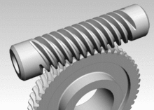
Worm (screw)
ALWAYS THE DRIVER
Worm Gear
ALWAYS THE DRIVEN
NOT REVERSABLE

Slide 14
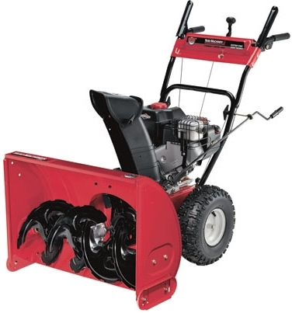
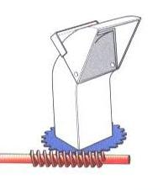

Slide 15
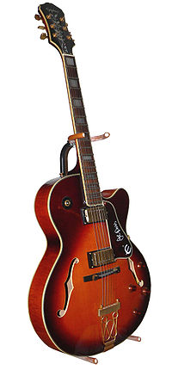
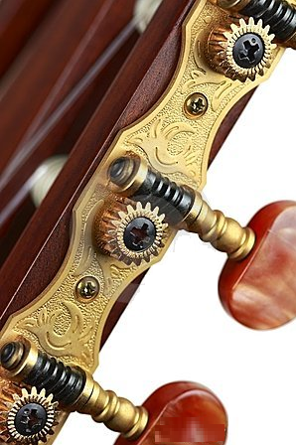

Slide 16
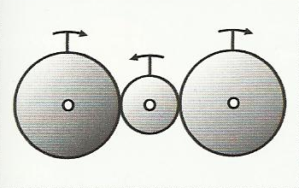
FRICTION GEAR SYSTEMS:
Can connect at different angles
Clockwise
Counter Clockwise

Slide 17
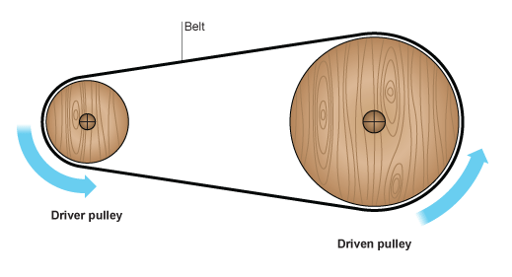
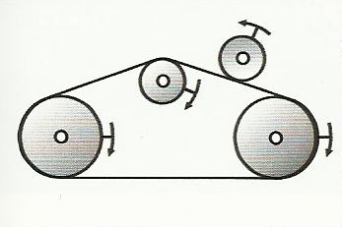
BELT AND PULLEY SYSTEMS:

Slide 18
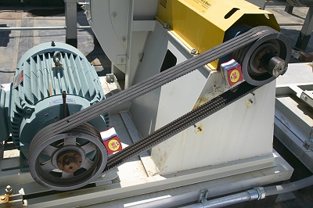
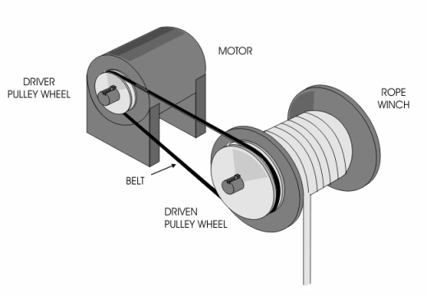

Slide 19
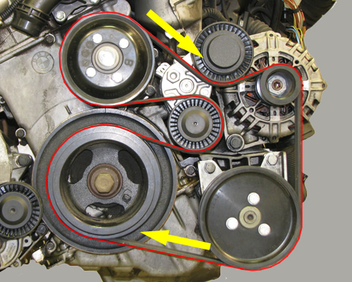
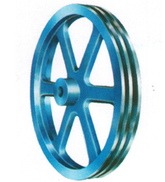
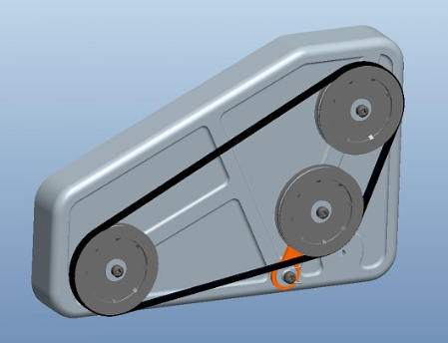
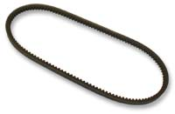
BELT AND PULLEY SYSTEMS ARE VERY COMMON IN AUTOMOBILE ENGINES

Slide 20
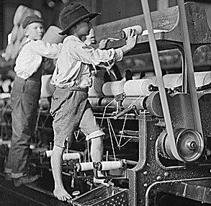
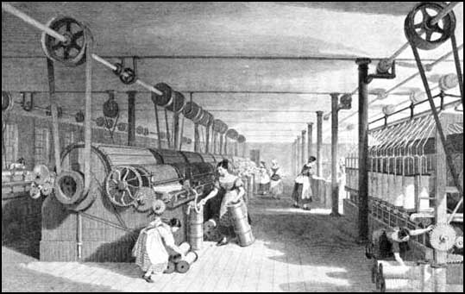
BELT AND PULLEY SYSTEMS WERE COMMON SITES IN FACTORIES
DURING THE INDUSTRIAL REVOLUTION

Slide 21
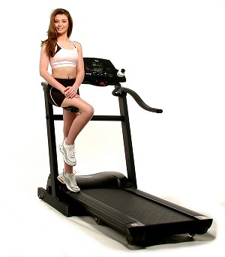
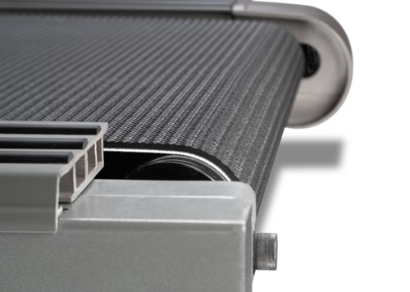

Slide 22
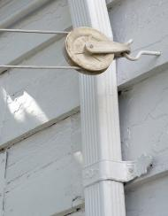
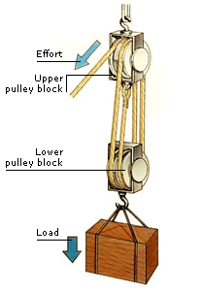
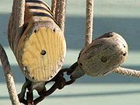

Slide 23
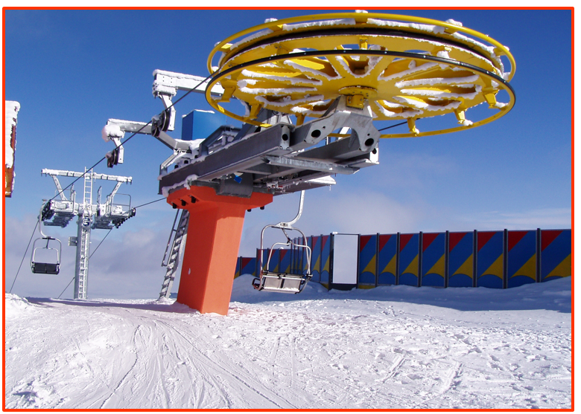

Slide 24
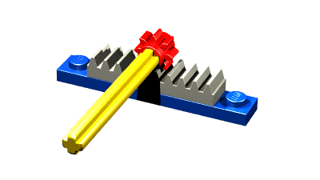
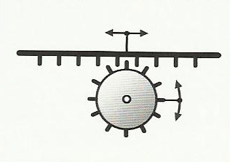
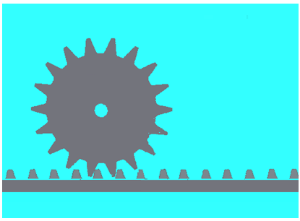
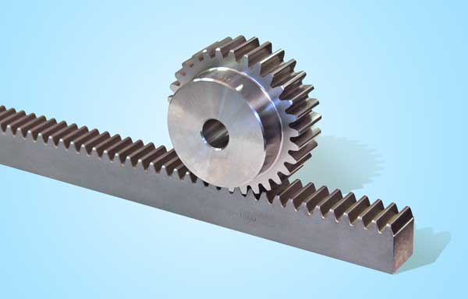
RACK & PINION SYSTEMS:
Pinion
Rack

Slide 25
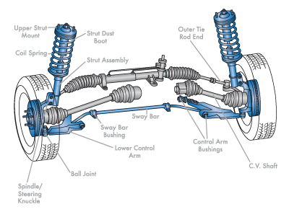
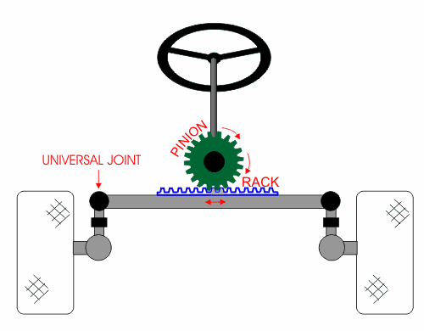

Slide 26




SCREW GEAR SYSTEMS:
Nut
Screw

Slide 27

Nut
Screw

Slide 28


CAM & FOLLOWER SYSTEMS:
Follower
Cam

Slide 29


Slide 30

Follower
Cam

Slide 31

Many possible Cam shapes and sizes for different purposes

Slide 32


Slide 33


Cam controlling Exhaust output timing of automobile engine
Cam controlling Air (O₂) and Fuel input timing into automobile engine

Slide 34

SLIDER-CRANK MECHANISMS:
Cam
Sleeve / Cylinder
Slider (Piston)
Connecting
Rod
Crank

Slide 35

Slider (Piston)
Crank
Sleeve / Cylinder
Connecting
Rod

Slide 36

Slider Crank Variation
(Similar to movement of Penguin legs from video)

Slide 37


Slide 38



Slide 39


LEVER SLIDE MECHANISM:

